Slide 1

Gradual Verification with Dafny
Eric Mercer*, Tyler Dean, and Cassidy Waldrip
Brigham Young University
Provo UT, USA
Sasha Fedchin and Jeff Foster
Tufts University
Medford MA, USA
Zvonimir Rakamaric and Robin Salkeld
Amazon Web Services

Slide 2

Designing high assurance systems is hard because failure risks reputation, safety, capital, etc.

Slide 3
Code review and test are widely understood but only sample the input and output space which is not always sufficient for assurance

Slide 4

Formal reasoning gives strong assurances through proofs of correctness but requires expertise that is not common
Notes:
Gradual verification follows. Introduce the example and show the gradual verification.
How do you move from formal traditional test dev to formal reasoning.

Slide 5
Correctness in Dafny
High Assurance Component
Inputs
Requires
Implementation
Ensures
Outputs
Hoare Triple
When requires are met, implementation establishes ensures
All loops in implementation terminate
The contract (requires and ensures) are a sound abstraction of implementation

Slide 6
Implementation
S₀
.
.
.
S_{i}
.
.
.
S_{x}
.
.
.
Reason hierarchically using abstractions
R_{i}
I_{i}
E_{i}
If it is not in the contract then its unconstrained in the proof of the Hoare triple
R_{x}
I_{x}
E_{x}
Notes:
Garbage in gives garbage out.
So proving an implementation meets its contract only cares about thinks in the contract and nothing else.

Slide 7
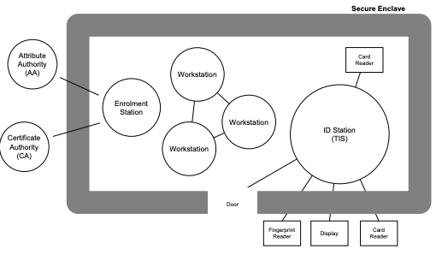
Access control with Tokeneer
Notes:
An Enrolment Station is used to issue a token to an approved user.
The Tokeneer ID Station (TIS) is a stand-alone “trusted” entity responsible for performing biometric verification of the user. To perform this task it makes use of the biometric information in the I&A Certificate on the user’s token and a fingerprint scan read from the user. If a successful identification is made then, assuming the user has sufficient clearance (held on the Privilege certificate), the TIS adds a signed Authorisation Certificate to the user’s token and releases the lock on the enclave door to allow the user access to the enclave.

Slide 8
class {:extern} Fingerprint {}
Define interfaces for existing components not being modeled
class {:extern} SecurityClearance {
predicate method {:extern}
isCleared(level : SecurityClearance)
}
class {:extern} Token {
predicate method {:extern} doesCertify(f : Fingerprint)
function method {:extern} getLevel() : SecurityClearance
}

Slide 9
class IdStation {
var alarm : bool;
var level : SecurityClearance;
method hasAccess_(t : Token, fingerprint : Fingerprint)
returns (hasAccess : bool)
requires !this.alarm
modifies this`alarm
ensures alarm == (!t.doesCertify(fingerprint))
ensures hasAccess ==
(!alarm && level.isCleared(t.getLevel()))
}
Object state (input)
Contract
Notes:
Create an internal method to define the behavior of hasAccess.

Slide 10
method {:test}
should_alarmAndDenyAccess_when_tokenDoesNotCertifyFingerprint()
{
var token : Token := tokenDoesNotCertify();
var fingerprint : Fingerprint := freshFingerprint();
var securityClearance : SecurityClearance := freshSecurityClearance();
var idStation : IdStation := new IdStation.IdStation(securityClearance);
var hasAccess : bool := idStation.hasAccess(token, fingerprint);
Assertions<bool>.assertTrue(idStation.alarm);
Assertions<bool>.assertFalse(hasAccess);
}
Dafny proves the assertions using only the contracts for the method calls

Slide 11

Notes:
Shell game because the fundamental issue has not gone anywhere, a model needs to be created and there needs to be some way to give assurance that the model is correct for some definition and that the actual implementation is faithful to the model. The fundamental problem is still there.
And there are new challenges: specifications can be complex and just as hard to write as the implementation and they use a formalism that is not always familiar leading to some common mistakes: unconstrained behavior or inconsistent specification.
The different though is that there are now two statements about what a component does: a specification _and_ an implementation. The tests should pass on both statements, so this differential tests over two ways to say the same thing increases assurance that what is written is what is wanted and what is generated and the proof certificate actually means something worthwhile.
The solution is test. Again. Write tests that build assurance that the specification says what it needs to say.

